Slide 1
ASP.NET Controls
Kaung San, Chaw Ei San
Software Engineering & Framework Environment
First Semester
MSC

Slide 2
What is ASP.NET Controls ?
ASP.NET controls are reusable building blocks that you can use to create the user interface (UI) of your ASP.NET web applications.
Some types of ASP.NET controls:
HTML Server Controls
Web Server Controls
Validation Controls
List Controls
It simplifies the development process by providing pre-built components for common UI elements like buttons, text boxes, and labels.
It provide features like server-side processing, state management and event handling, which make it easier to create dynamic and interactive web pages.

Slide 3
HTML Server Controls
<input type="text" id="txtName" runat="server" />
<input type="text" id="txtName" runat="server" />
These controls are standard HTML elements that have been extended to allow server-side processing.
The runat="server" attribute makes it accessible from server-side code.

Slide 4
Web Server Controls
<asp:TextBox ID="Value1" Columns="2" MaxLength="3" Text="1" runat="server"/>
<input type="text" id="txtName" runat="server" />
These controls are ASP.NET-specific controls that provide a wider range of functionality than HTML server controls.
Tell text box to take
two column width
limiting the user input to 3 characters.
This is a more feature-rich text box compared to HtmlInputText. It offers properties like MaxLength, ReadOnly, and more.

Slide 5
Validation Controls
<asp:RequiredFieldValidator ID="RequiredFieldValidator1" runat="server"
ControlToValidate="txtName" ErrorMessage="Name is required!" />
<input type="text" id="txtName" runat="server" />
These controls are used to validate user input on web forms. For example, a required field validator can be used to ensure that a user enters a value in a required field
This control ensures that the txtName TextBox is not left empty. If it is, an error message is displayed.

Slide 6
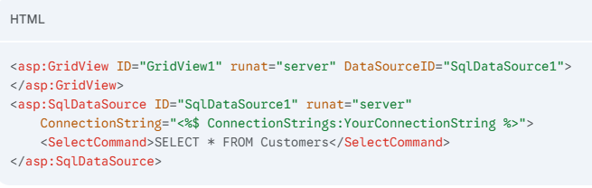
List Controls
his control displays data from a database (in this case, the Customers table) in a grid format.
<input type="text" id="txtName" runat="server" />
List controls are designed to bind to data (such as a dataset retrieved from a database)
and display this data on the page.
There are three types of list controls:
Repeater
DataGrid
DataList
This control displays data from a database (in this case, the Customers table) in a grid format.

Slide 7
View State
Imagine an online shopping cart.
When you add items, the cart needs to "remember" what you've added.
View State helps the page keep track of the items in your cart even after you navigate to different product pages.
HTTP is Stateless: By default, HTTP is a stateless protocol. This means the server has no memory of previous interactions with the client.
Imagine you're filling out a form online. You enter your name, address, and other details. When you click "Submit," the page refreshes. Without View State, you'd have to re-enter all that information!
View State is like a memory for your web page. It saves the current state of the page and its controls (like textboxes, dropdown lists) between requests.

Slide 8
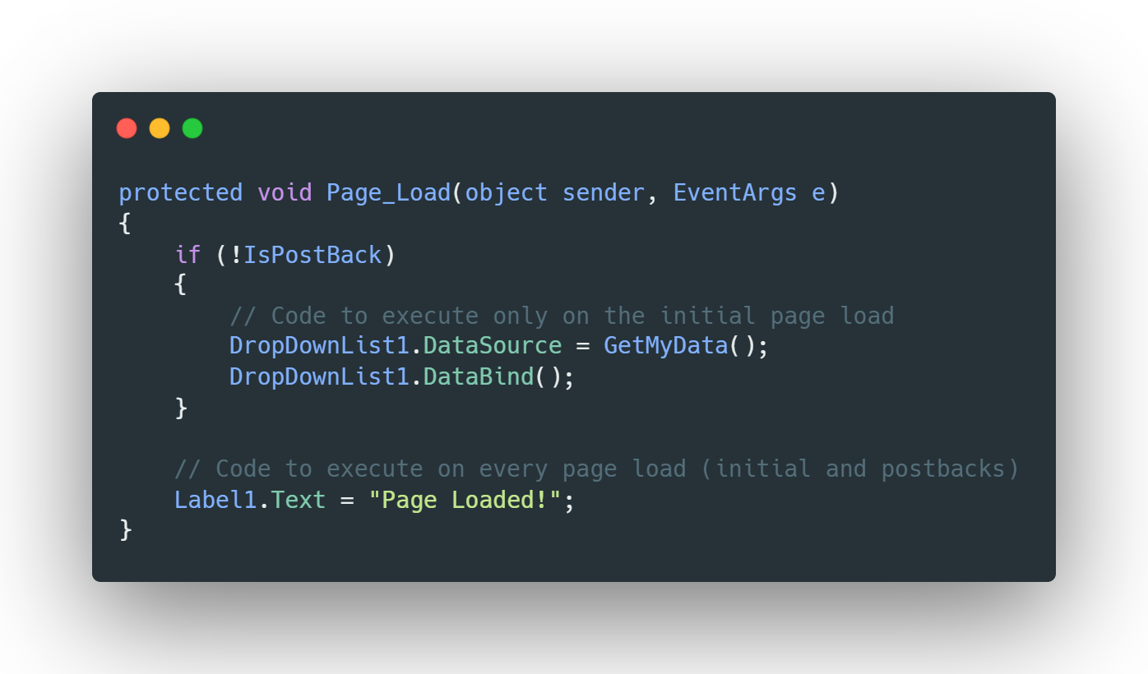
Page_Load() Event
This event fires every time a page is loaded, whether it's the initial load or a postback (e.g., after submitting a form).
Key Use Cases:
Data Binding: Populating controls with data from databases or other sources.
Initialization: Setting initial values for controls.
Conditional Logic: Checking for postbacks (IsPostBack property) to avoid redundant operations.

Slide 9
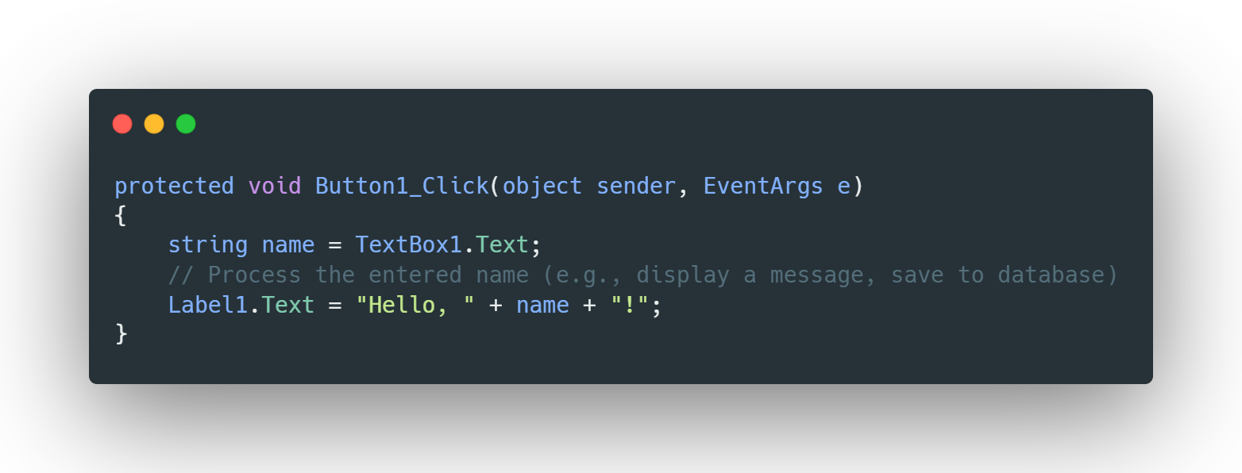
On_Click() Event
This event fires specifically when a button (or other control with an OnClick event) is clicked.
Key Use Cases:
Handling User Actions: Performing actions based on button clicks (e.g., submitting forms, saving data, navigating to other pages).
Validating Input: Checking user input for errors before processing.

Slide 10
List Controls

Slide 11
Repeater Control
The Repeater control is the simplest of the list controls; it is a barebones control for working with lists of data. The Repeater control renders items in a list based on developer-defined templates.
How it Works:
Data Source: The Repeater control binds to a data source (like a database, an array, or a collection).
Template: You define a template within the Repeater control that specifies how each item in the data source should be rendered.
Rendering: For each item in the data source, the Repeater control creates a new instance of the template and populates it with the corresponding data.

Slide 12
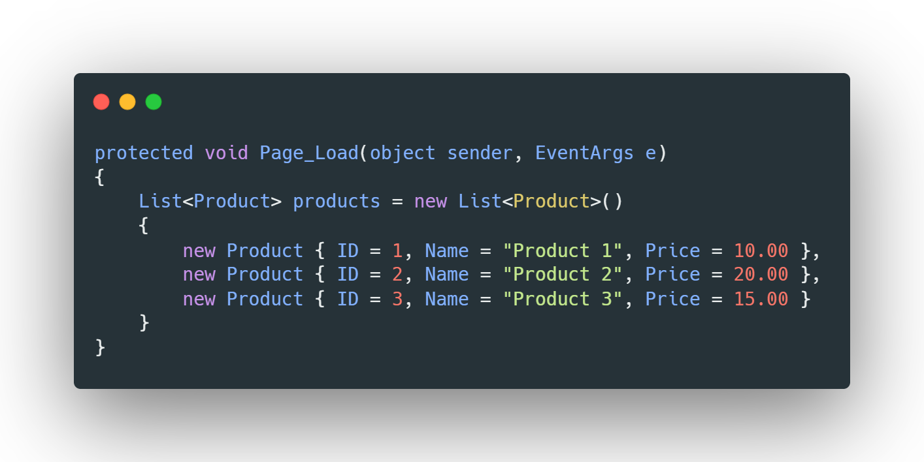
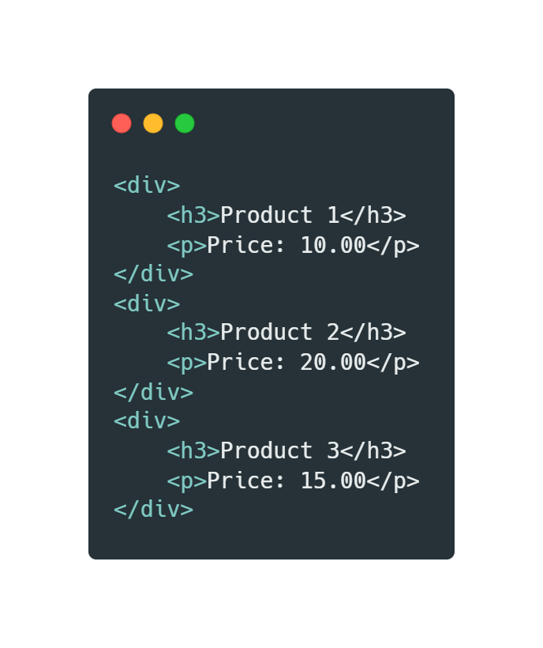
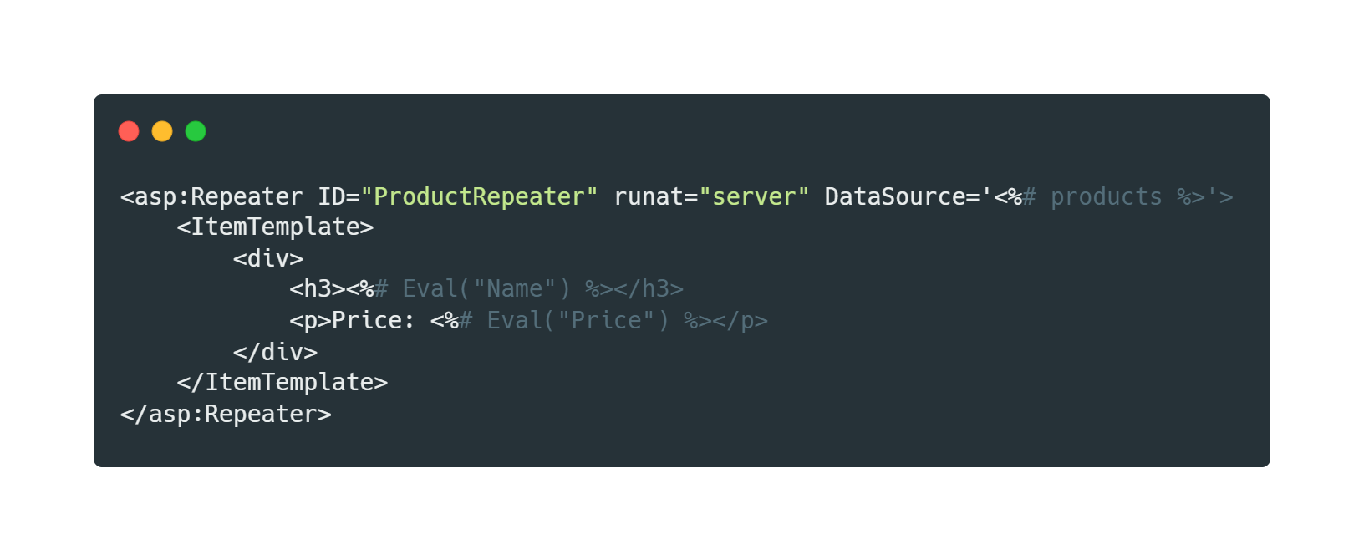
Example
Output

Slide 13
Data List Control
The DataList control allows you to display data in a flexible and customizable format. It's similar to the Repeater control but offers some additional features and a slightly higher level of abstraction.
DataList supports some common list operations such as the ability to display the list items across multiple columns, select items in a list, and edit items in a list.
Key Features:
Data Binding: Like the Repeater, it binds to a data source (e.g., database, array, collection).
Templates: You define templates to control the appearance of data items.
Built-in Features: Provides some built-in features like automatic data formatting and basic editing capabilities.
By default, the DataList control renders the data within an HTML table structure.

Slide 14
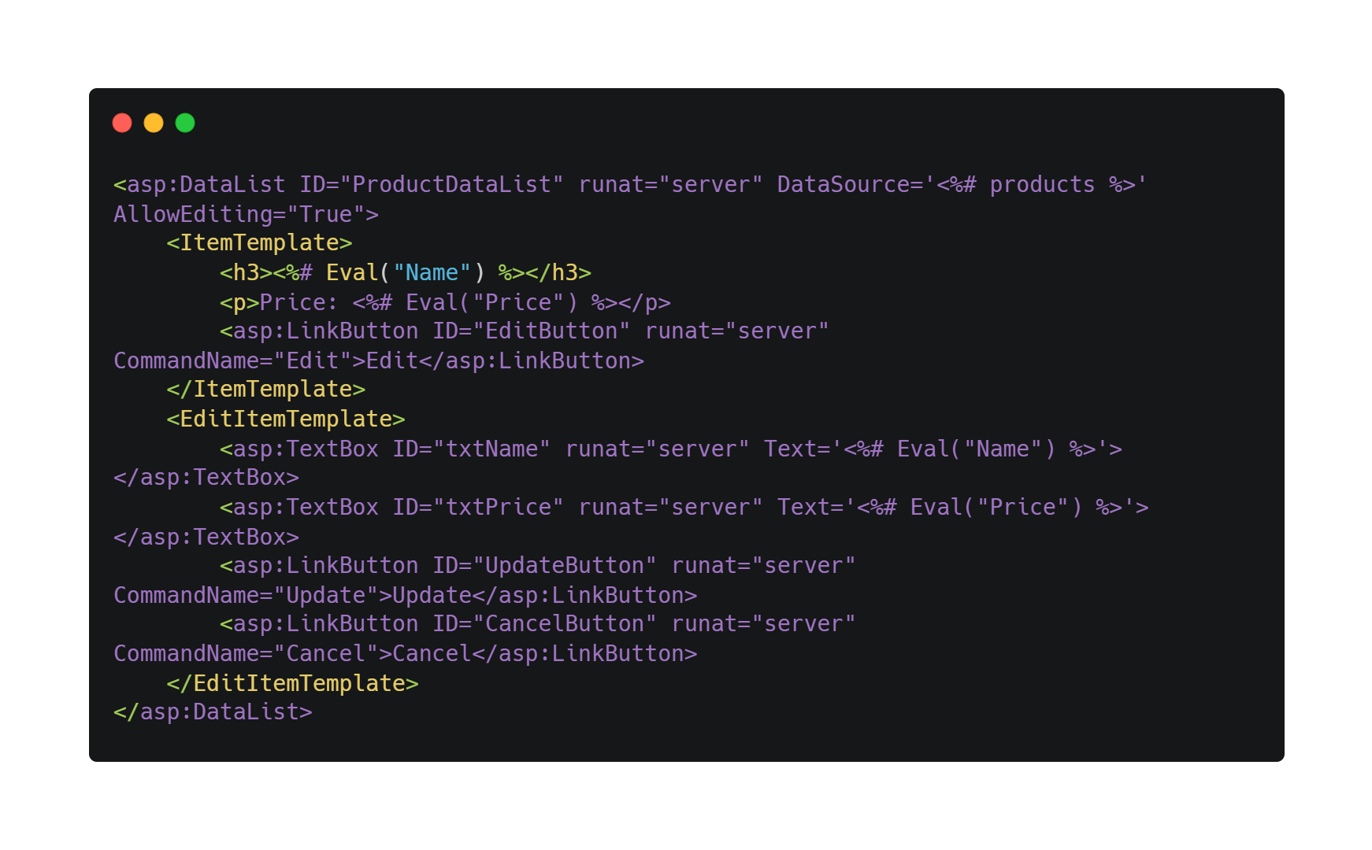
Example

Slide 15
Data Grid Control
The DataGrid control is used to display and manipulate tabular data. It provides a structured way to present information from various data sources, such as databases, arrays, or collections.
Key Features:
Data Binding: Easily binds to various data sources.
Built-in Features: Offers features like sorting, paging, editing, and deleting.
Customization: Highly customizable through templates and properties.
Data Formatting: Supports data formatting for better presentation.

Slide 16
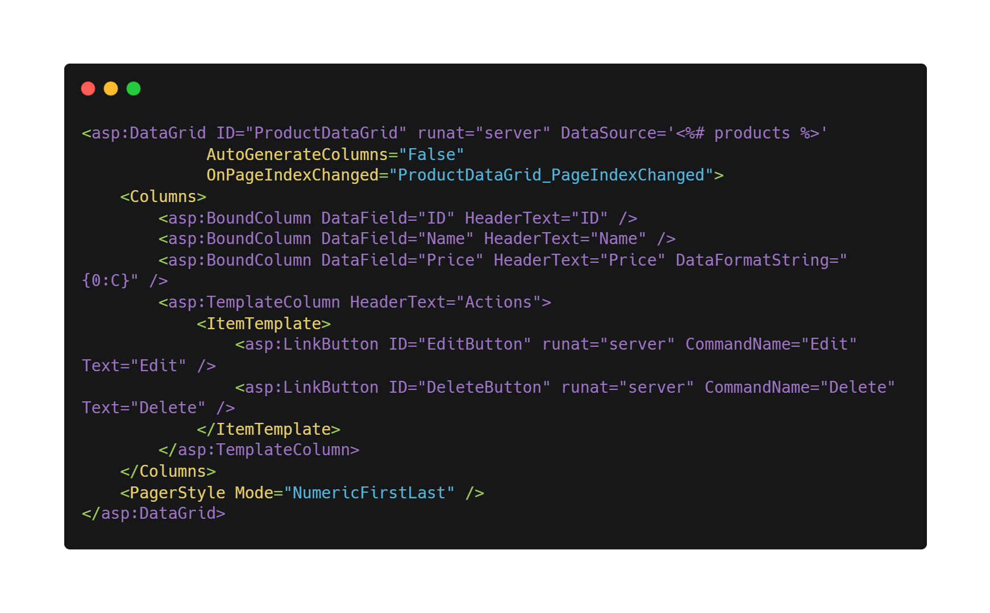
Example

Slide 17
Thanks

